Slide 1
Mindset
This Photo by Unknown Author is licensed under CC BY-NC

Slide 2
Did you ever think about
Why some students try so hard in school, in sports, at their job?
Why some people seem highly motivated and others do not?
There are of course, a lot of possible reasons for this, however
A lot of research has shown that there is a powerful relationship between students’ mindsets and their achievement.

Slide 3
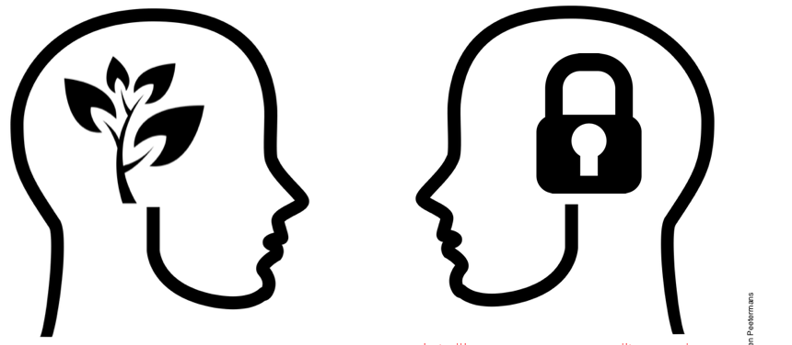
Growth Mindset vs. Fixed Mindset
Psychologist Carol Dweck found that students generally hold one of two very different beliefs about intelligence.
Some have a fixed mindset - they believe intelligence doesn’t change much, you’re born with a certain amount of it, and there’s not much you can do to change it.
Others have a very different belief about intelligence - a growth mindset. They see it more like a muscle that grows with effort.
These beliefs become lenses through which students interpret their day-to-day experiences, especially challenging ones.
This Photo by Unknown Author is licensed under CC BY-SA-NC
These interpretations then determine the behaviors students choose to engage in. If a student believes there isn’t a point in trying, they won’t attempt to.

Slide 4
Beliefs about intelligence and learning impact your:
Motivation
Academic behaviors (i.e.. studying and seeking help)
Responses to challenges and setbacks
Academic achievement

Slide 5
The Consequences
Your beliefs affect the goals you have, how you view effort, and how you respond to failure and setbacks.

Slide 6
The Consequences
Look Smart
With a fixed mindset, students want to show how smart they are, or hide how ‘dumb’ they think they are. They want to make sure to show they’re smart so they rarely ask questions in class or seek out help because that would involve showing they don’t know something.
Students with a growth mindset have the goal to learn, so they’re more likely to ask a question if they don’t understand, or to seek out help or try a new strategy if they are struggling.

Slide 7
The Consequences
Look Smart
Students with a fixed mindset actually see effort as proof of low ability. They think that if you have to try hard that means you aren’t very smart.
Students with a growth mindset see effort as how you grow your abilities.

Slide 8
The Consequences
Look Smart
Fixed mindset students tend to have a helpless response to failure or struggling with something they don’t immediately get. They give up because they see setbacks as evidence that they ‘don’t have what it takes’.
Give Up
Work Harder
Students with a growth mindset are more likely to work harder in response to a failure.

Slide 9
Over time,
Students with a fixed mindset tend to show declines in their performance, particularly when they transition to a new environment such as middle school to high school, high school to college etc.
Students with a growth mindset typically show increases in their achievements over time.

Slide 10
The Cycle
This is how mindset impacts achievement. One of these cycles takes place when students experience a challenge or setback.
Higher Achievement
Increased Effort
Growth Mindset
Which path do you usually take?
Challenge or Failure
Fixed
Mindset
Reduced Effort
Lower Achievement
Notes:
NOTE: THIS SLIDE IS ANIMATED. [ADVANCE] INDICATES WHEN YOU SHOULD CLICK ADVANCE TO BRING UP THE NEXT PART OF THE SLIDE.
The reason these mindsets can have such an impact on achievement has to do with the recursive process that takes place when students experience a challenge or setback.
[ADVANCE] When a student w/ a GMS experiences a setback
[ADVANCE] they increase their effort
[ADVANCE] which leads to better results
[ADVANCE], which then reinforces their belief that they can improve – it reinforces their growth mindset.
[ADVANCE] Students with a fixed mindset have the opposite recursive process taking place. [ADVANCE] They experience a failure,
[ADVANCE], they reduce their effort,
[ADVANCE], which leads to lower achievement over time,
[ADVANCE] which then reinforces their belief that they don’t ‘have what it takes.’

Slide 11
What is your Mindset?
Do you see yourself in one of the 2 beliefs?
Is it possible you are somewhere in between?
See the PDF called Mindset Quiz to learn about your mindset. Please share your results with me.
Could you have a growth mindset sometimes and a fixed mindset other times?

Slide 12
Your Results
We all have a combination of fixed and growth mindsets in different domains of our life.
You might have a growth mindset about your ability to improve at a sport, for example, but believe you are ‘not good at math’.
People can also have intermediate mindsets - not fully fixed or growth.

Slide 13
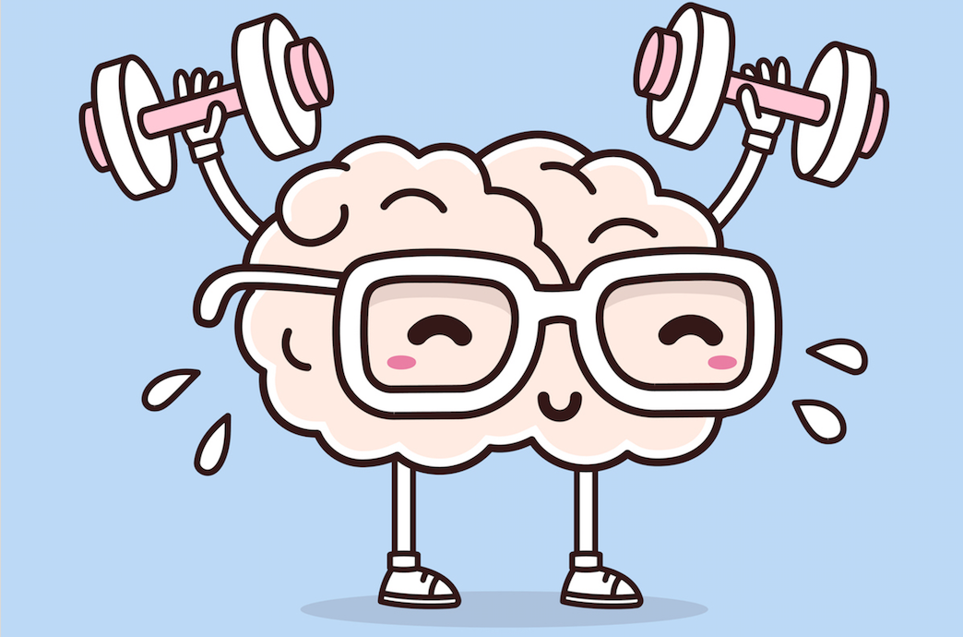
Luckily, Mindset can Change!
Research shows that mindsets can change.
When fixed is changed to growth mindset, students achieve better.

Slide 14
Nobody has a growth mindset in everything all the time.
We all have fixed-mindset triggers that cause us to give up trying.
They might be low self-confidence, not enough sleep, heavy workloads, criticism, challenges, or even nice weather on a Friday afternoon.
It is important to identify your triggers and learn strategies to overcome them.

Slide 15
Fixed Mindset Triggers
Stop!
When you feel yourself reacting in a way that’s threatening your progress, stop and work out what has triggered you.
Notice how this is like the problem-solving process we saw last week?
Don’t judge!
Don’t judge yourself for your feelings, they are real and valid. Acknowledge, accept, but don’t let them define what you do next.
Explore!
Explore some alternative strategies to solve your problem.
Conquer!
Conquer the trigger, don’t give up!

Slide 16
Your Superpower
Conquering your fixed mindset triggers doesn’t mean challenges become easy, we just look at them differently.
You have the Power….the Power of Yet!
What does this mean to you?
Have a look at how it is explained on Sesame Street
(yes, you’ve had this power since you were a child)

Slide 17
Summary
believe everyone can improve with effort, practice, good strategies, and help.
believe in and love lifelong learning
Having a growth mindset doesn’t mean everyone has equal ability in every domain. It means you:
persevere through rough spots
learn from mistakes
Some suggestions for developing a growth mindset can be found at this link

