Slide 1
How do You Think?
This Photo by Unknown Author is licensed under CC BY-SA

Slide 2
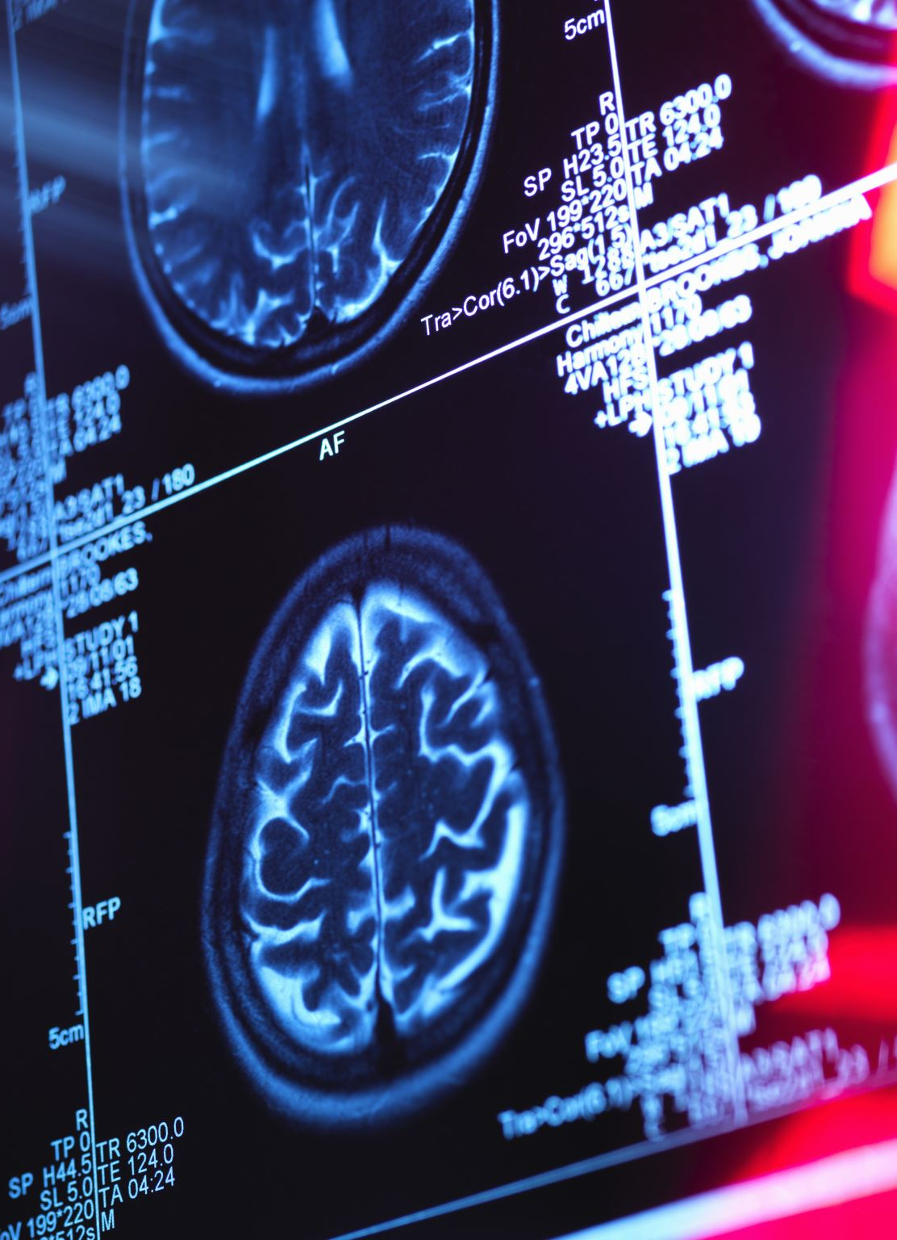
With your brain, of course!
Your brain is divided into 2 halves, left and right hemispheres
While they look alike, they function differently
It is said that if you are mostly analytical and methodical in your thinking, you’re left-brained
If you tend to be more creative or artistic, you’re thought to be right-brained

Slide 3
LEFT BRAIN
RIGHT BRAIN

Slide 4
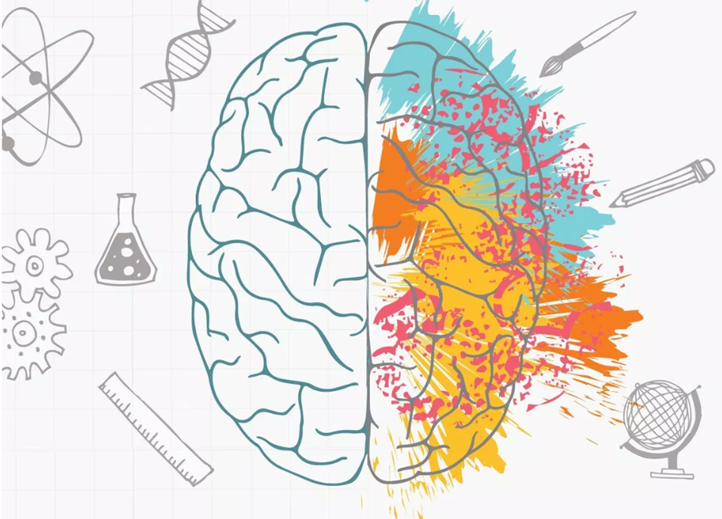
Where do your strengths lie?
Do you consider yourself to be more analytical (left-brained) or creative (right brained)?
Try this simple test (or one like it) and see whether you agree with the results https://www.youtube.com/watch?v=VY0E01G6ZWE

Slide 5
Test Results
If you are like most people, your results will be fairly equal for left-brain and right-brain strengths
This is because unlike having a dominant hand, we do not have a dominant side of the brain
Research has found that while the two sides of our brain are different, there are certain areas that have specialties and these areas can vary a bit from person to person
(Source https://www.healthline.com/health/left-brain-vs-right-brain#left-brainright-brain-theory)

Slide 6
Research shows… (Source https://www.psychologytoday.com/us/blog/brain-myths/201206/why-the-left-brain-right-brain-myth-will-probably-never-die)
in healthy people the two brain hemispheres are well-connected and operate together, sharing information
both halves of the brain play important roles in logical and intuitive thinking, in analytical and creative thinking, etc.
you don’t ever use only one side of your brain at a time
like a bicycle, the parts of the brain do have different functions, but they are designed to work together

Slide 7
What this means
We all use all of our brains; none of us are truly “left-brained” or “right-brained”
Whether you’re performing a logical or creative function, you’re receiving input from both sides of your brain
For example, the left brain is credited with language, but the right brain helps you understand context and tone. The left brain handles mathematical equations, but right brain helps with comparisons and rough estimates

Slide 9
Think about how we solve problems
This Photo by Unknown Author is licensed under CC BY-NC

Slide 11
So
Whether you’re working out a complicated algebraic equation or painting an abstract work of art, both sides of your brain are actively participating and providing input.
You’re not truly left-brained or right-brained, but you can play to your strengths and continue broadening your mental horizons. A normal, healthy brain is capable of lifelong learning and boundless creativity.

Slide 12
In the Workplace
Regardless of your preference, you ARE a creative and critical thinker, and this is great news!
You have the ability to detect, analyze, and evaluate problems and
while it is true that there are obvious solutions to many common problems in the workplace, creative individuals tackle situations from all angles, generating original ideas and unique ways of solving problems.

Slide 13
Improving your Skills (and mine too)
Research ways you can improve both creative and critical thinking skills.
Share your sources with me as well as 2 tips to improve each way of thinking

Slide 14
More tips for a sharp brain
In addition to thinking exercises, your brain benefits from a good physical workout. Just 120 minutes of physical activity each week can help improve learning and verbal memory.
Avoid too much junk food and be sure to get all the essential nutrients you need through diet and, of course, aim for a full night’s sleep every night.

Slide 15
Finally… here is a fun activity to get many areas of your brain working. Did you solve it?

