Slide 1
Hospitality and Tourism Introduction

Slide 2
What is your definition of:
Hospitality
Tourism

Slide 3
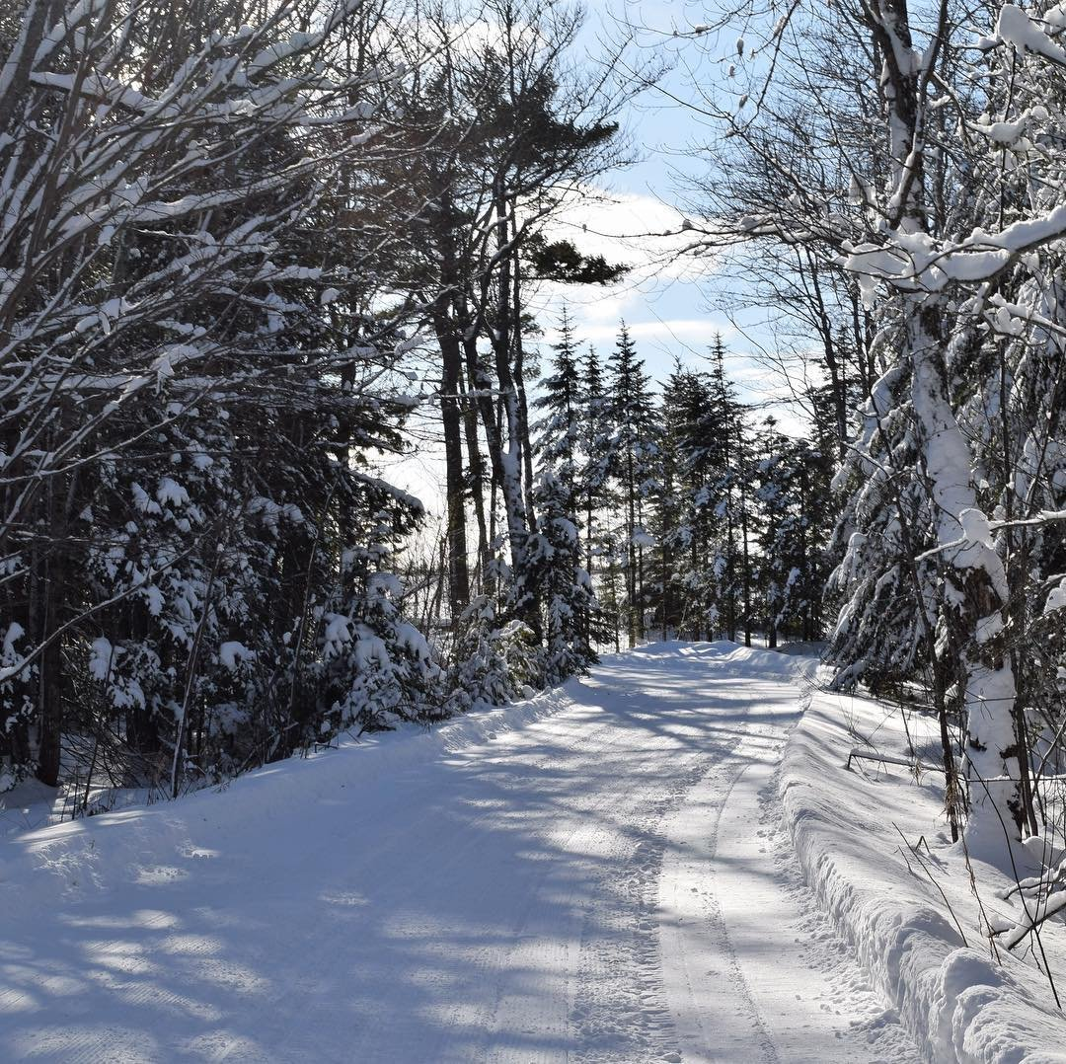
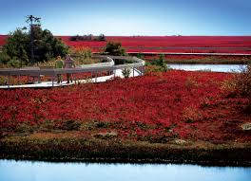
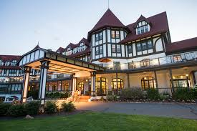

Slide 4
Hospitality and Tourism
.
Hospitality means the friendly reception and treatment of guests or strangers—the industry refers to a broad category of businesses such as hotels, bars, and restaurants that offer people food, drink or a place to sleep.
Tourism is defined as the activities of persons travelling to and staying in places outside their usual environments for not more than one consecutive year for leisure, business or other purposes

Slide 5
Tourism vocabulary
Visitor
Visitors are travelers taking a trip to a destination outside their usual environment, for less than a year, for any purpose (business, leisure or other personal purpose) other than to be employed by a resident entity in the country or place visited.
Tourist
Visitors are classified as tourists (or overnight visitors) if their trip includes an overnight stay. In other words, tourists are visitors who stay overnight.
Excursionist
Visitors are classified as excursionists if they make a same-day visit. An excursionist does not have an overnight stay.
Inbound tourism
Inbound tourism includes the activities of non-resident visitors from other countries or other regions.
For example, if a resident of Norway travelled to Canada for a holiday, Canada would define this activity as inbound tourism or the traveller as an inbound tourist.
Inbound tourism can also apply to a region.
Ex. If a resident of Ontario went to Newfoundland, Newfoundland would consider the traveller as an inbound tourist or the activity as inbound tourism.

Slide 6
Tourism vocabulary
Outbound tourism
Outbound tourism includes the activities of travellers outside of their regions or countries of residence (where they live permanently).
For example, if a resident of Canada visits the United States, Canada would consider this activity as outbound tourism or the traveller as an outbound tourist.
Outbound tourism can also apply to a region.
Ex. If a resident of New Brunswick visited Nova Scotia, New Brunswick would consider the activity as outbound tourism or the traveller as an outbound tourist.
Outbound visitors can be tourists or excursionists.
Domestic tourism
Domestic tourism is used to refer to the activities of a resident of a country travelling within their country of residence. The point of reference is commonly the country of residence.

Slide 7
Tourism vocabulary
Tourism expenditure
Tourism expenditure refers to the amount paid for the acquisition of consumption goods and services, as well as valuables, for personal use or to give away, for and during tourism trips. In other words, all the money you spend when travelling.
International tourism
An international tourist is a term used for a resident of one country who takes a trip to another country.

Slide 8
What are
Goods
Services

Slide 9
Goods and Services
Goods VS Services.. goods are tangible, services are intangible.
Service: an intangible think that is a task performed for customers by a business (room clean, check in)

Slide 10
Did You Know?
The pineapple is the international symbol of hospitality.
Columbus brought pineapples back to Europe in 1493 where their sweet taste was an instant hit with the wealthy. Pineapples were a rare commodity and as such, were given as gifts to royalty and displayed on dining tables of the elite. Over time, pineapples became a symbol for welcome, friendship and hospitality.

Slide 11
Why study Hospitality and Tourism?

Slide 12
Answer the following:
What were your summer jobs?
Does your job effect the tourism industry?
How seasons affect tourism jobs?
How does tourism affect your family?
What influence does tourism have on the province?

Slide 13
Now, what does hospitality and tourism mean to you? Answer the following questions.
What are the first five things that pop into your head when you think of hospitality and tourism?
Describe your favourite travel experiences to date. What made it a special experience?
Describe your worst hospitality and tourism experience to date. What made it a bad experience?
What are three hospitality and tourism experiences you want to do in the future?
What skills do you think are required to work in the hospitality and tourism industry?

Slide 14
In early years, people travelled for the following reasons:
Survival
Religious pilgrimages and holy festivals
Business and trading of goods
Personal enjoyment (for example, adventure, celebration, education and leisure)

Slide 15
Motivations for Travel
Why do people travel?
What motivates them to travel?
Take a few minutes to think of ten reasons why people travel.
Don't limit your thoughts to just one type of travel—think
of local travel, international travel, frequent travel, once-in-a-lifetime
travel...
Next, think of reasons why people might decide not to travel

Slide 17
Measuring Tourism Handout
How many travellers from other countries visited Canada?
How many travellers from another country visited New Brunswick?
Which province had the fewest international tourists? Why do you think that is?
How many travellers from Canada visited other countries?
How many Canadian excursions were taken by Canadian travellers?
Which province had the most international tourists?
How many tourist trips were taken by Canadians in Canada?

Slide 18
International Tourism Worldwide: 2016
1,235 million tourists travelled to different countries
Travellers spent 1.4 trillion dollars on international travel
1 in 10 jobs worldwide are in the travel industry
France, US, Spain and China were the most popular destinations
By 2030, it is expected that 1.8 billion people will travel out of country

Slide 19
TRENDS IN HOSPITALITY & TOURISM
Safety
Diversity
Ecology
Markets- Target market, examples, spas’s and gaming, legalize gambling
Convenience - 24 hour locations, express check in and out, special programs, use the internet to make arrangements
Technology

Slide 20
Impacts of tourism
The impacts can be economic, social or environmental. They can be either positive or negative.
Brainstorm the impacts in each category.

Slide 21
Economic
There are more than 400 different jobs connected to the tourism industry, and they require different skills, experience and education.
Not only does the tourism industry meet the
needs of its customers. It promotes local businesses.
Tourism in Canada
Provides 1.7 million jobs to Canadians
Accounts for 1 out of 11 jobs in Canada
Accounts for 5.2% of total businesses across Canada
Is worth $90.3 billion dollars

Slide 22
Social
Promotes local area, province and country
Promotes culture and history of the area

Slide 23
Environment
The International Ecotourism Society defines ecotourism
as "responsible travel to natural areas that conserves the environment and sustains the wellbeing of local people."

Slide 24
Ecotourism
The International Ecotourism Society defines ecotourism as "responsible travel to natural areas that conserves the environment, sustains the well-being of local people, and involves interpretation and education."
Green tourism
Green tourism is a certification rating given to an organization’s sustainability performance against a set of criteria that are aligned with the Global Sustainable Tourism Council Criteria. An organization’s score determines their award level: Bronze, Silver or Gold.
Agrotourism
Agrotourism consists of tourists participating in rural culture. Tourists work voluntarily on a farm and participate in the local culture.

Slide 25
Environmental Impact:
Water Resources
Land and Air resources
Waste disposal
Threatened locations
Noise pollution
Visual pollution

Slide 26
Promoting your area and return Tourists
Everyone can contribute to making tourists feel welcome, and help to ensure that they keep returning.
Locals, just like tourism employees, become ambassadors. We all contribute to the positive impression that a visitor has of our beautiful surroundings.
You can get involved in tourism from an early age—after all, two out of every five tourism workers are between 15 and 24 years of age.

Slide 27
what might a travel experience look like in 100 years?
Changes in technology
What innovations in technology are likely when you consider current trends?
Will online hackers disrupt the online economy? How might that impact the travel industry?
Changes in the environment
Will the world manage climate change?
Will air pollution restrict the amount of travel?
Will ocean beaches disappear as water rises?
Will we even have clean water to drink?
Changes in the economy
Will the rich keep getting richer and the poor keep getting poorer or will wealth be distributed more equally?
Will robots disrupt the economy so that there is significant unemployment?
Will the green economy provide new employment?

Slide 28
what might a travel experience look like in 100 years?
Changes in values
A recent trend has more people buying local and travelling local to reduce their environmental footprint.
Will the current trend of reducing your environmental footprint impact tourism?
Will people continue to seek adventure and new experiences?
Changes in politics
Will governments do more to protect the environment by heavily taxing the industry and making travel only for the wealthy?
Will some countries close their borders to travellers?
What type of passport will you need to travel to another country?
What types of security will be in place when travelling?
Will the world be a safer place or a more dangerous place to travel?

Slide 29
If the World Wide Web has only been around for 30 years, and airplane travel has only been accessible for 60 years, what will the future look like in 100 years!
Pick two influences from the above categories that you think will have the most significant impact on the way we’ll live hundred years from now. Briefly list the reasons why you chose your selected categories.
List three significant changes for each of the categories you selected with a short description of the change.
Pick a travel experience you would like to take during this future time period. Describe how the changes will impact your travel experience. Be creative and imaginative! Based on the changes, include the following:
Your destination and why you chose it
How you booked your travel and the means in which you travelled to your destination?
Where you stayed and the types of meals available?
What amenities were included in your accommodations?
Describe two different experiences during your trip.

Slide 30
Assignment
Choose one of the following issues, research both pros and cons relating to that issue, and write a cited paper on it.
Support your points with references. Be sure to include a bibliography of the works you consulted and a Works Cited page.

Slide 31
Issues
Tourism's impact on local culture, people's awareness of heritage, and
pride in community and country
Tourism's impact on the environment, including the impact of ecotourism
Tourism's impact on the economy and local development

