Slide 1
Viruses
Chapter 19
Page 478

Slide 2
The phylogeny of the virus
No fossil evidence
Only speculation:-
ancestors were cellular parasites that gradually lost their cell structures.
rogue genes that have escaped from the chromosomes of living cells.

Slide 3
The discovered:
tobacco mosaic virus (p. 478) which caused spots on tobacco plant leaves.
Scientists couldn’t isolate it because it was too small to be seen with a light microscope. (A large virus is much smaller that a small bacteria cell but is larger than a molecule.)

Slide 4
Definition
Viruses are:
tiny particles that enter living cells and use the cell’s “machinery” to produce more virus particles.
made of nucleic acid, and, in some cases, lipids.
(Nucleic acids are biological molecules essential for life, and include DNA (deoxyribonucleic acid) and RNA (ribonucleic acid.)

Slide 5
Why do most biologists not consider viruses to be alive? They:
do not “eat”;
cannot reproduce except by using cell’s;
don’t have any organelles;
crystallize
When you have a cold, it is caused by a virus and antibiotics will not work because a virus is not alive.

Slide 6
Classification of viruses
Viruses are classified based on the host they infect.
- Animal viruses: mumps, measles, HIV, Ebola, West Nile, Herpes, TB
- Plant virus: Tobacco Mosaic Virus
- Bacteria virus: Bacteriophage

Slide 7
A typical virus is composed of a core of DNA or RNA surrounded by a protein coat.
The simplest virus has just a few genes whereas the most complex have more than a hundred.
http://www.youtube.com/watch?v=7iVm1uEIyP0

Slide 8
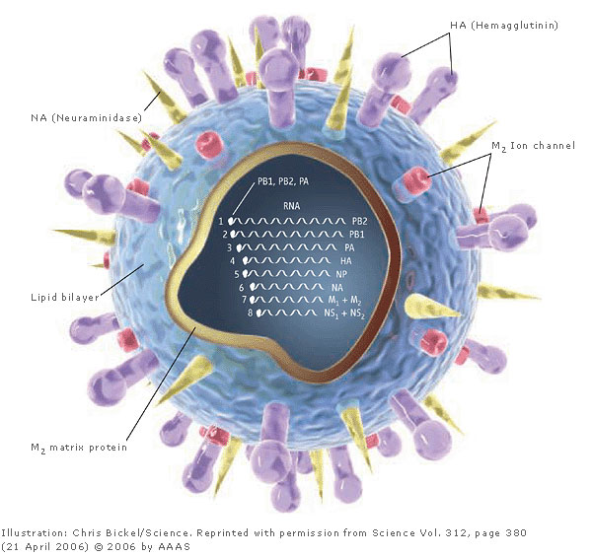
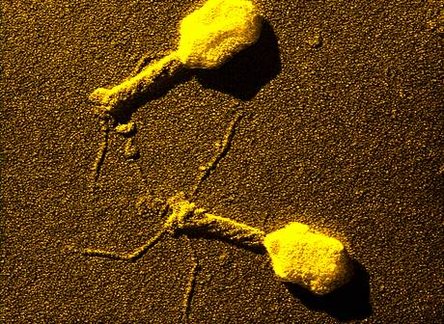
Virus types
Bacteriophage
Influenza Virus

Slide 9
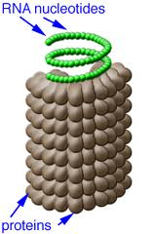
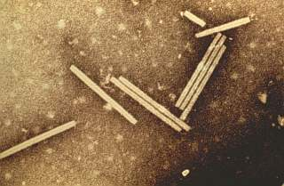
Tobacco Mosaic Virus

Slide 10
A virus’s protein coat is called its capsid.
The capsid includes proteins that enable a virus to enter a host cell by binding to receptors on the host cell.
Most viruses infect only certain cells.

Slide 11
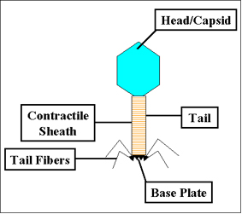
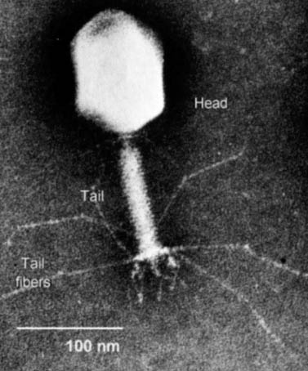
Bacteriophage

Slide 12
How exactly does a virus get onto a cell?
Flu virus:
http://www.youtube.com/watch?v=Rpj0emEGShQ&feature=related
Bacteriophage:
http://www.youtube.com/watch?v=Dh4C-qmfuro&feature=related

Slide 13
Viral infection: Once a virus is inside the host cell, it may cause two different processes to occur.
1. Lytic infection:
A virus enters the host cell, makes copies of itself, and causes the cell to burst, sending the copies out.
http://www.youtube.com/watch?v=wVkCyU5aeeU&NR=1

Slide 14
2. Lysogenic infection:
Virus integrates its DNA into the host cell’s DNA so that every time the cell divides, it makes a copy of the viruses DNA too. (The viruses DNA which in embedded in the host cell’s DNA is called a prophage.)
A lysogenic infection may become a lytic infection.
http://www.youtube.com/watch?v=_J9-xKitsd0&feature=related

Slide 15
Retroviruses
Contain RNA as their genetic information.
When retroviruses enter a cell’s nucleus, they cause DNA to be made from their RNA.
Some retroviruses remain dormant for long periods of time.
HIV is a retrovirus.

