Slide 1
There are one hundred thousand bacteria squirming around on every square centimeter of your skin.

Slide 2
Bacteria
In this video clip, watch for the shapes of the different bacteria.

Slide 3
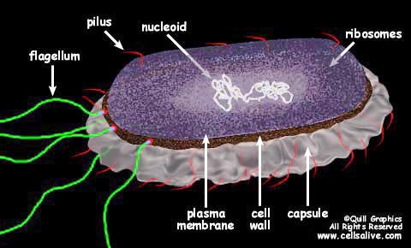
Bacteria

Slide 4
Parts of a bacteria (see board for diagram):
Cell wall (eubacteria with peptidoglycan)
Cell membrane (sometimes called plasma membrane)
Pili (some)
Flagella (some)
Ribosomes
Nucleic acid in the form of DNA or RNA (sometimes, in addition to the main loop, there is one or more additional circular loops of DNA or RNA called plasmids)
Endospore (some)

Slide 5
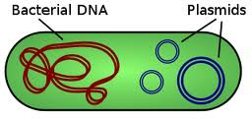

Slide 6
Remember that bacteria are classified into two domains and two kingdoms.
Domain: | Bacteria | Archae
Kingdom: | Eubacteria | Archaebacteria

Slide 7
Remember the general characteristics of Eubacteria and Archaebacteria:
Prokaryotic
Unicellular
Autotrophic and heterotrophic
Have cell walls

Slide 8
Differences between Eubacteria and Archaebacteria:
Eubacteria | Archaebacteria
Cell walls made of peptidoglycan | No peptidoglycan in cell walls
Live all around and inside us. | Live in extremely harsh environments

Slide 9
Classification of bacteria
Prokaryotes are classified by characteristics such as:
their shape,
the chemical make-up of their cell walls,
the way they get their energy, and
The way they reproduce

Slide 10
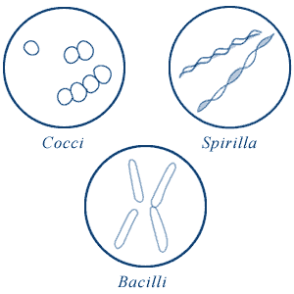
1. By shape

Slide 11
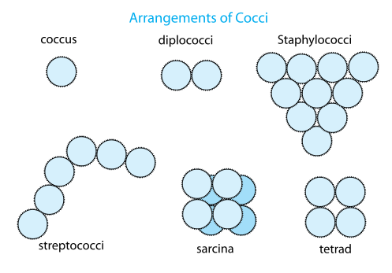
The shapes
1. Coccus (cocci)
- spherical (round) cells
- single, in pairs, chains or clusters

Slide 12
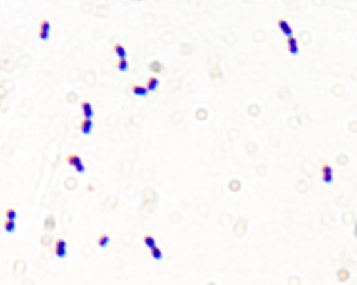
Examples of cocci:
Diplococcus (pneumococcus bacteria)

Slide 13
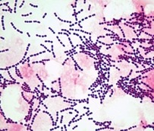
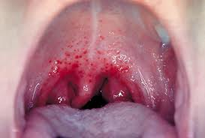
Examples of Cocci: Streptococcus (strep throat)

Slide 14
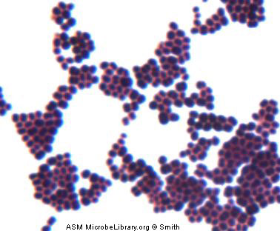
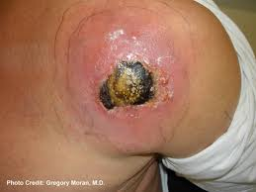
Examples of Cocci Staphylococcus (gangrene)

Slide 15
b. Bacillus (Bacilli)
- rod-shaped cells
- single, in pairs, some with many flagella
Examples:
salmonella (food poisoning)
Botox (hand, face, armpits)
typhus, botulism (found in soil, canned food)
gonorrhea (STD)
anthrax
yogurt

Slide 16
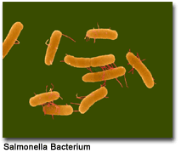
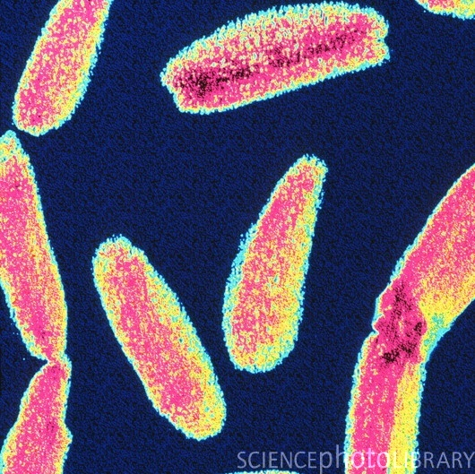
Salmonella
Anthrax

Slide 17
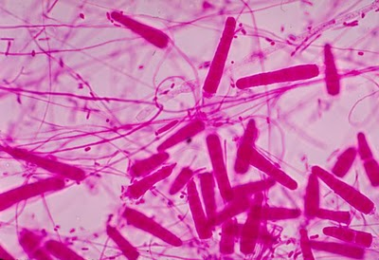
Yogurt

Slide 18
c. Spirillum (spirilla)
- spiral
- only single cells; no colonies
- 3 different spirals (see board)

Slide 19
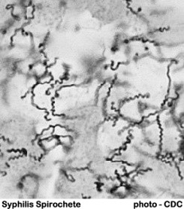
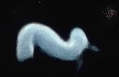
Syphilis
Spirilar fever (from rat bites)

Slide 20
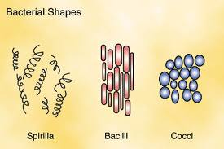

Slide 21
You may also have noticed that sometimes bacteria join together. The number of bacteria that join and the way in which they join are also used to identify and classify bacteria.

Slide 22
For the purposes of biology 12-2, remember that:
Coccus, Bacillus, Spirillum | One bacteria of that shape
Two-joined together | Diplo Cocci, bacilli
Bunch together, triangular shape | Staphylo Cocci
Chain of more than 2 | Strepto Cocci

Slide 23
2. Cell walls
Remember that Archaebacteria do not have peptidogycan in their cell walls. Eubacteria do have peptidoglycan.
In Eubacteria, there are two types of cell walls.
A technique called gram-staining is used to tell them apart. First, a violet coloured gram stain is applied. It stains the peptidoglycan in the cell wall. An alcohol treatment is then applied. This dissolves the outer lipid layer and removes the violet coloured dye.

Slide 24
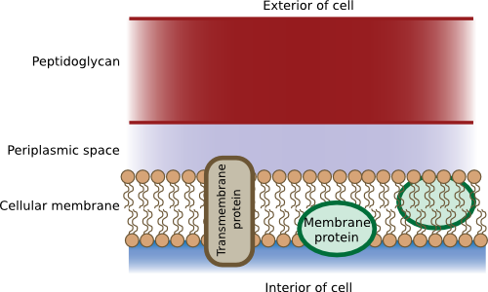
Gram-positive bacteria have thick peptidoglycan walls that hold the stain better and keep the dark violet colour.

Slide 25
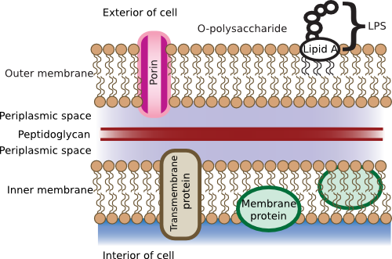
Gram-negative bacteria have thinner peptidoglycan walls and have 2 membranes: an outer and an inner with the cell wall between them. This provides more protection to the bacterium.

Slide 26
Getting Energy
All cells in organisms need energy and carbon to carry out their functions. For example, animals get both their energy and carbon from eating food.
When we classify organisms, including bacteria, we look at how they get both their energy and the carbon they need.

Slide 27
3. Getting energy & carbon:
a. Heterotrophs (consume):
- Chemoheterotrophs: Must take in organic molecules (living or once living things) for both energy and a supply of carbon.
- Photoheterotrophs: Use sunlight for energy and take in organic molecules for carbon.

Slide 28
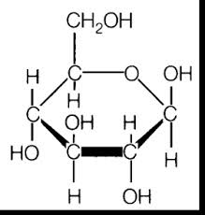

Slide 29
Autotrophs:
Chemoautotrophs: Get both energy and carbon from consuming non-organic sources.
Photoautotrophs: Use sunlight to convert inorganic molecules to both carbon compounds and food energy.
Cyanobacteria, one of the photoautotrophs, has chlorophyll which gives it a blue-green colour.

Slide 30
Releasing energy (still under #3 “Getting Energy”)
Bacteria need a constant supply of energy that they can use. This energy is converted to energy that the cell can use by the process of cellular respiration or fermentation or both.
a. Organisms that require a constant supply of oxygen (for cellular respiration) to live are called obligate aerobes.
(Obligate = obligated)
Ex. Mycobacterium tuberculosis

Slide 31
b. Some bacteria not only do not require oxygen (fermentation), they are killed by it. These are called obligate anaerobes. They must live in the absence of oxygen.
Ex. Costridium botulinum (Botulism), which lives in the soil. It can also grow in sealed cans.

Slide 32
c. Some bacteria can survive with or without oxygen (cellular respiration and fermentation). These are facultative anaerobes.
(Facultative means that the organisms have the faculty to function in different ways, depending on the environment.)
Ex. E. coli

Slide 33
4. Reproduction
http://www.youtube.com/watch?v=gEwzDydciWc

Slide 34
a. Binary Fission (asexual):
Splitting in two
Involves one cell only (not male and female cells)
Makes exact replicas
http://www.youtube.com/watch?v=3cD3U2pgb5w&feature=related
http://www.youtube.com/watch?v=vTzH1P3aQjg&feature=related

Slide 35
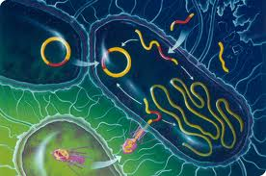
Conjugation

Slide 36
b. Conjugation:
It is always better for a species to share DNA so that every member of the species is not exactly the same genetically.
Some bacteria share part of their DNA. In these bacteria, there is the main strand of DNA and also some smaller circles with part of the DNA in them. These small circles of DNA are called plasmids.

Slide 37
One bacterium (donor) will transfer s a copy of its plasmid to another bacterium (recipient).
Once the recipient gets the donor’s DNA, it is forever changed and has the characteristics that were passed to it. It can also pass these characteristics along.

Slide 38
http://www.youtube.com/watch?v=O-EdX4MaMFE&feature=fvwrel

Slide 39
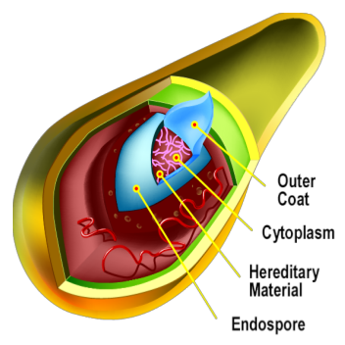
Endospore

Slide 40
Spore formation
In severe conditions (like a freezer), most bacteria can produce a thick internal wall called and endospore around their DNA and a part of their cytoplasm.
Bacteria can stay dormant, protected by their endospore, for days, months, sometimes years until conditions are better and they can then become active and reproduce.

Slide 41
The Importance of Bacteria
Bacteria are vital to maintaining the living world. Some are:
decomposers that help break down the nutrients in dead matter for re-using;
nitrogen-fixers (Plants and animals need nitrogen to make proteins) that help convert atmospheric nitrogen (in the air) to a form of nitrogen that plants can use, nitrates, in a process called nitrogen fixation.

Slide 42
Some bacteria help:
humans produce certain vitamins in our bodies,
digest some foods,
produce other foods,
clean-up oil spills,
remove waste products and poisons from water,
help mine certain minerals, and
help in the making of certain drugs.

Slide 43
Other bacteria are harmful to other organisms. Those bacteria that grow on food do so more rapidly in certain conditions:
Food – Different bacteria use different nutrients.
Acidity – In general, “bad” bacteria thrive in acidic environments.
Temperature – Between 4 and 60 degrees Celsius
Time
Oxygen
Moisture

Slide 44
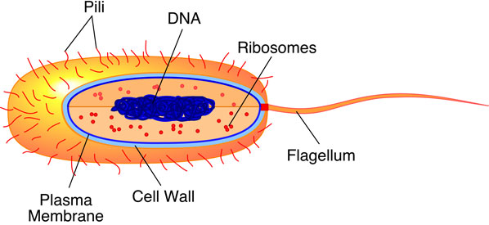

Slide 45
Review
Draw a Venn diagram showing the similarities and differences between Eubacteria and Archaebacteria.
What factors are used to identify and classify prokaryotes?
What are some ways that prokaryotes obtain energy?
Why might an infection by a gram-negative bacteria be more difficult to treat than one caused by gram-positive bacteria?

